Slide 1
The importance of health system strengthening to respond climate change challenges
Elizabet Paunovic

Slide 2
Presentation layout
Climate change as the biggest health threat of the 21st century
What is health system vulnerability?
What is health system adaptive capacity to climate hazards?
National adaptation strategy (health)
Conducting vulnerability and adaptation assessment of the health sector
Budapest Declaration of the Seventh Ministerial Conference on environment and health, 2023
Prioritization of the activities related to health and climate change so far in Ukraine
Conclusion

Slide 3
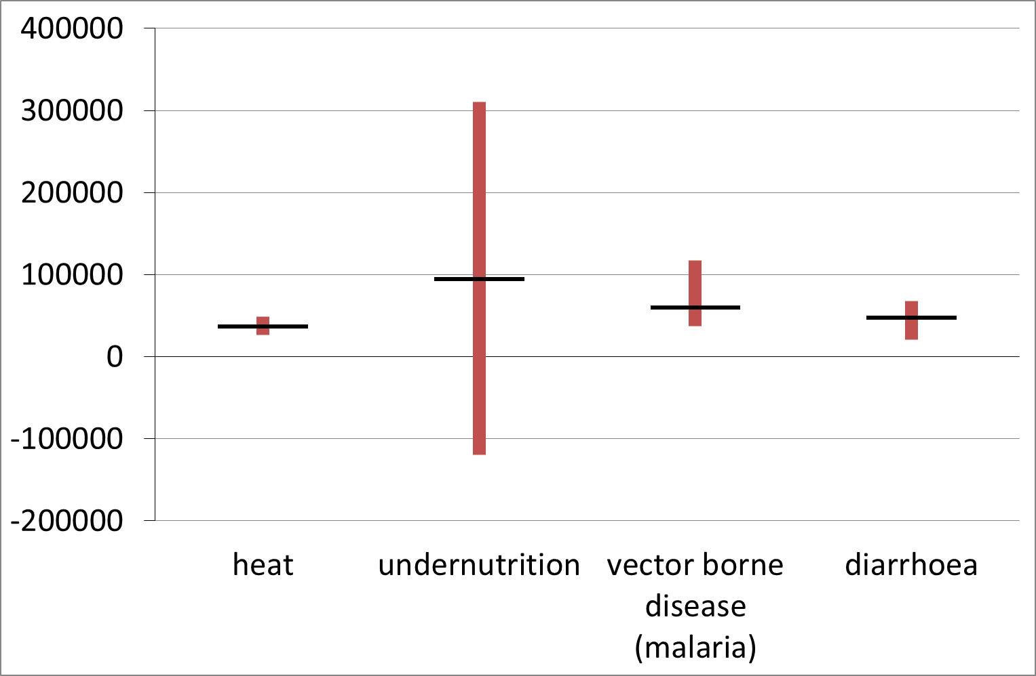
Climate change as the biggest health threat of the 21st century
Source, IPCC 6th Report https://www.ipcc.ch/report/ar6/wg2/downloads/outreach/IPCC_AR6_WGII_FactSheet_Health.pdf
Notes:
These days we are expecting the new 2023 Report, but already the 2022 report of the Lancet Countdown was published as the world confronted profound and concurrent systemic shocks. Countries and health systems continue to contend with the health, social, and economic impacts of the COVID-19 pandemic, while Russia's invasion of Ukraine and a persistent fossil fuel overdependence has pushed the world into global energy and cost-of-living crises. As these crises unfold, climate change escalates unabated. Its worsening impacts are increasingly affecting the foundations of human health and wellbeing, exacerbating the vulnerability of the world's populations to concurrent health threats. Iy is expected that climate change related deaths will achieve more than 250.000 excess deaths per year by 2030.

Slide 4
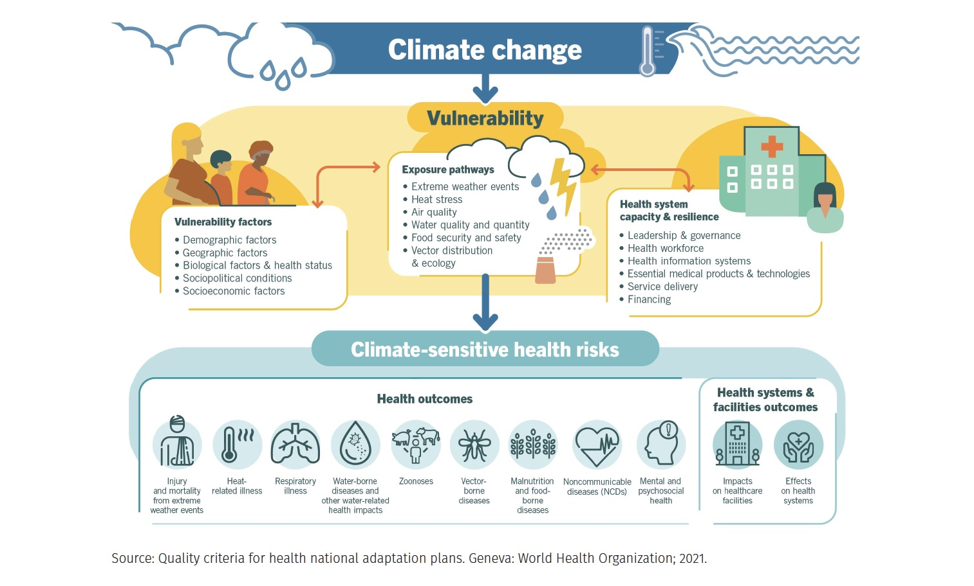
What is health system vulnerability?
Notes:
Different harmful factors caused by climate change can make health systems vulnerable to the impacts of these factors. Let me mention these of the biggest concern: extreme weather events, heat stress, air quality, water quality and quantity, food security and safety, vector distribution and ecology.
The other group of factors external to the health system, that are influencing the extent of the health system vulnerability are demographic, geographic, biological, health status, socio-p
political and socioeconomic.
In addition, existing health system capacity and resilience factors are also influencing health sector vulnerability. Let me mention some of them: leadership and governance, health workforce, health information systems, essential medicines and technologies, service delivery and financing.
Influenced by these complex factors, health sector has to address climate-sensitive health risks in the context of public health (injuries, heat stress, respiratory diseases, zoonoses, vector born diseases, NCDs…) and health systems and facilities outcomes impacting directly health facilities and health systems.

Slide 5
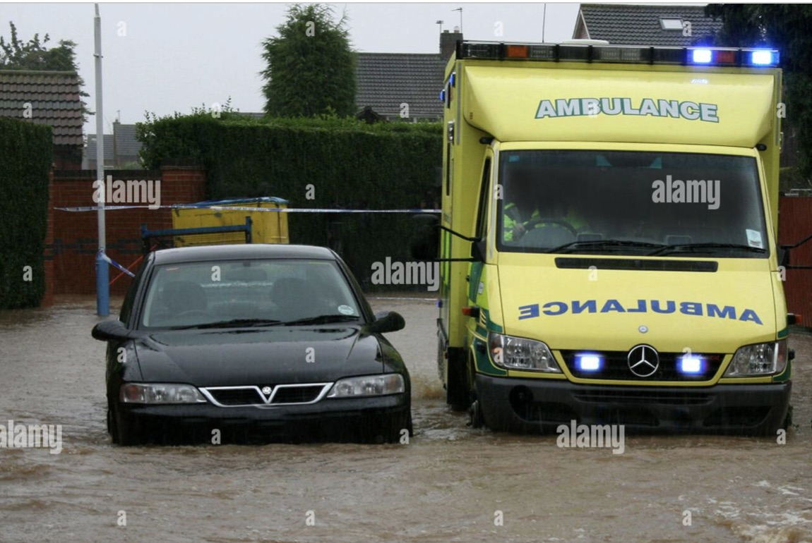
What is health system adaptive capacity to climate hazards
Notes:
In parallel with the struggle and activities aimed on mitigating the effects of climate change, climate change is happening now and it is a necessity to adapt to the current challenges related to climate change impacts on helath.
Budapest Declaration (2023) is Highlighting the importance of integrating the environmental and climate change dimensions within health systems for the provision of quality of care and towards attaining universal health coverage;
Health system capacity is a determinant of vulnerability, adaptive capacity is the capability of individuals, communities and nstitutions such as health systems to effectively adjust to climate hazards, or prepare for, respond to and cope with the consequences of climate variability and climate-related health risks. Information about climate change impacts on health systems and human health is needed to build or increase adaptive capacity for supporting action plans to strengthen health adaptation strategies.
Prioritization of the adaptation options should be based on the information from V&A assessments. Health adaptation actions must be developed and implemented through iterative decision-making, including health authorities, all relevant health parts at different levels, partners outside the health sector, civil society and communities.

Slide 6
National adaptation strategy (health)
Preparing the ground for the adaptation
Assessing risks and vulnerabilities to climate change
Identifying adaptation actions
Assessing adaptation actions
Implementation
Monitoring and evaluations
Notes:
A national adaptation strategy or action plan is developed in order to reduce vulnerability to climate change and to facilitate integration of climate change adaptation into existing policies in a coherent manner. Health sector adaptation plan can be developed as the stand alone document, or as the part of the national adaptation strategy. In Ukraine process started as the part of the National adaptation strategy in 2019.
It addresses the main barriers to the integration of climate change adaptation into national, sectorial, and local government planning and budgeting, as well as support the formulation of financing strategies and mechanisms for the scaling up of medium- and long-term adaptation.
“Mainstreaming the environment and climate into post-war reconstruction is in the interests of the citizens of Ukraine,” said Chloe Allio, Head of the Economic Cooperation, Energy, Infrastructure and Environment section of the EU Delegation to Ukraine. “This will require that long-term climate change effects are considered, along with adaptation measures to address these changes. The active involvement of local communities and Ukrainian citizens in adaptation planning at the local level is an important step in this direction.”
Here, we can see the stages in the development of the national health adaptation strategy to climate change.

Slide 7
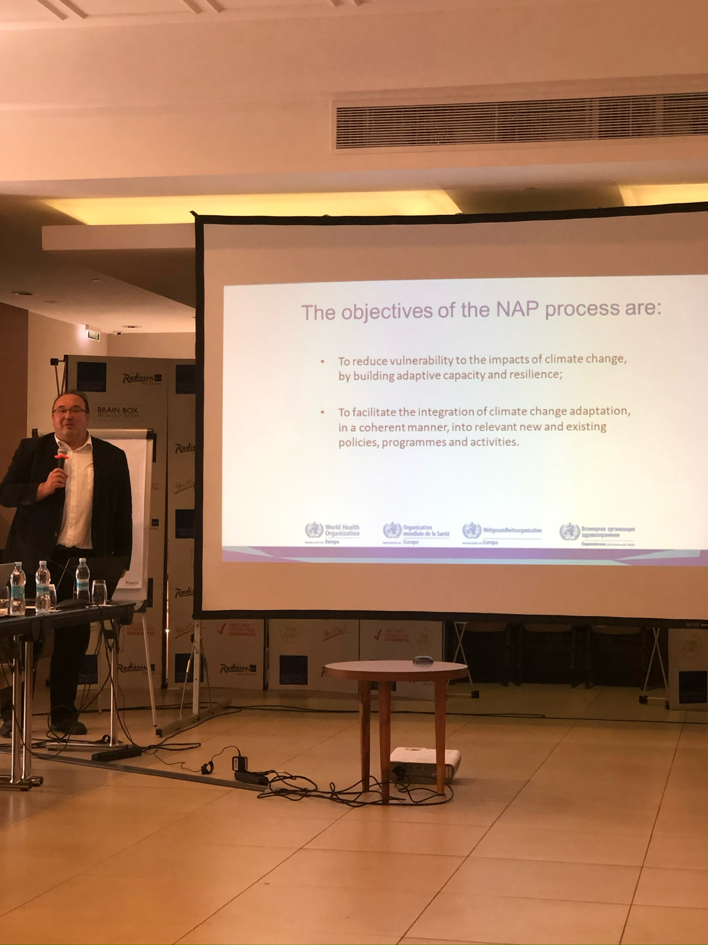
Conducting vulnerability and adaptation assessment of the health sector
Notes:
According to WHO methodology the process of introducing health concerns into adaptation startegies should start by establishing a project team and management plan, including representatives from other departments and ministries. Identify the questions to be addressed and the policy context.
Defining the health risks, outcomes, geographical region and time period that will be thfocus of the assessment.
Establishing a stakeholder process, including populations that could be affected by climate change.
Identifying information and data to inform the assessment.
Conducting vulnerability and adaptation assessment is the key part of this process– describing the current burden of climate sensitive health outcomes and vulnerabilities to climate variability and recent climate change. There is a good quality toolkit developed by WHO to support these activities.
Here is the photo from the 2019. workshop held in Kyiv when this process started in Ukraine supported by EU and WHO.

Slide 8
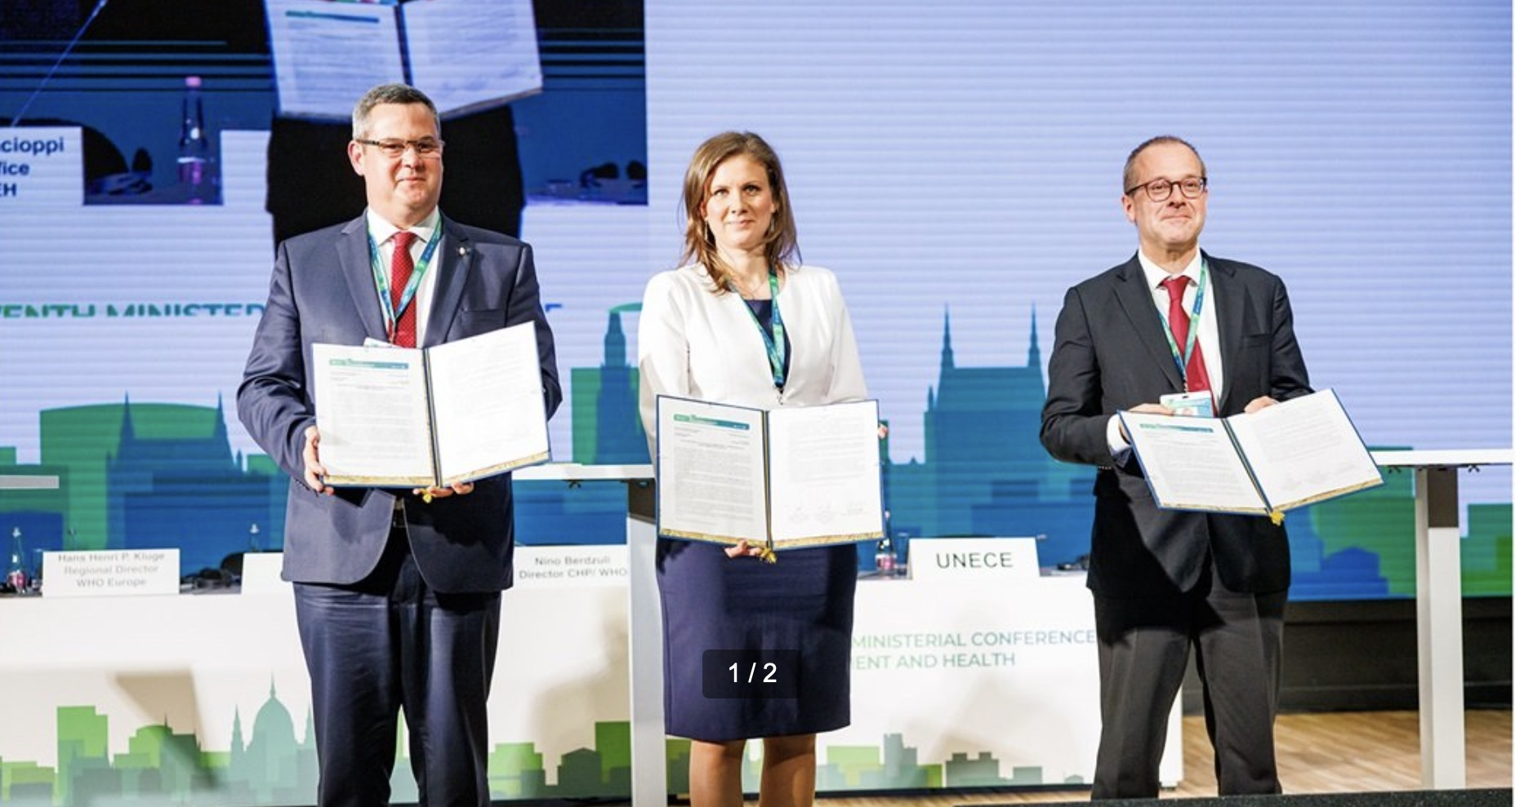
Budapest Declaration, 2023
Notes:
What are the new frameworks for action to support countries in health system adaptation on climate change? In the 2023. Ministerial Declaratiion of the 7th Ministerial Conferece on Environment and Health, the misister of health and of environment comited themselves to will enhance efforts to tackle the health and well-being impacts of climate change through adaptation and mitigation action by the health and health-determining sectors, inter alia,by:
Making health systems and facilities climate-resilient and environmentally sustainable, and by striving for decarbonizing service delivery in alignment with the COP26 Health Programme;
By developing, updating, and implementing Health National Adaptation Plans (H-NAPs),
either as stand-alone documents or integrated as part ofNational Adaptation Plans (NAPs);
Developing and updating heat-health action plans to effectively prevent, prepare for and respond to heat-related health risks, while adapting urban planning to address the impacts
of urban heat island effects, taking into account the competencies of different levels of
governance;
Establishing and updating regulatory requirements to ensure the climate resilience of water and sanitation services, and, where appropriate, promoting the reuse ofwastewater, while
ensuring that it is safe for health and protects the environment;
Strengthening natural disaster risk reduction policies and climate-informed health early-
warning and surveillance systems for extreme weather events and climate-sensitive disease
outbreaks;
Strengthening the climate-literacy of health professionals to empower them to respond to
climate health impacts and engage meaningfully on climate change policy development in the health sector.

Slide 9
Protecting Health from Climate Change Proposed actions for Ukraine
Conduct Ukrainian national health vulnerability, impact and adaptation assessment of climate change
Develop and implement a national action plan for public health adaption to climate change as the part of national adaptation strategy to climate change
Contribute to the drafting of the Ukrainian National Adaptation Strategy to climate change for the period up to 2030
Contribute to the drafting and submitting for the approval the medium-term plan of action for adaptation of Ukrainian agriculture to climate change (assessing health risks)
Development of training modules on climate change impact monitoring for public health and training for specialists of Public Health Centers and State Committee for Consumer Safety
Notes:
One of the identified priorities in the Portfolio is the impact of climate change to human health. The special emphasis was put on legislation and the key cross-sectoral documents of implementation, in particular the development of the National Action Plan on Climate Change under Ukrainian context and ways of further implementation.

Slide 10
Conclusion
It would be necessary to continue activities that started 4 years ago on the development of health sector adaptation plan, as the part of the national climate change adaptation plan. The climate and health crisis is aggravated by COVID-19, war, energy crisis, poverty and overall health vulnerability of the population in Ukraine.

Slide 11
Дякую

